Slide 1
Installation Manual for
Cord Organizer of KAT Walk mini
KATVR technical service center

Slide 2
Catalogue
1、Unboxing
2、Cord Organizer Installation
3、Wireharness connected to headset

Slide 3
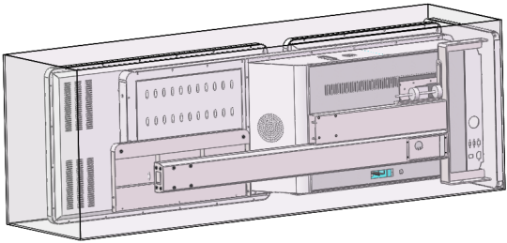
1、Unboxing
1. Place【Control Center wooden box】on flat ground，use【claw hammer】or other tool to open it.
2.Take out 【Control Center】、【Cord Organizer】、【The anti-dumping support】、【toolbox】all these items from【wooden box】.
Note: Keep the Control Center screen from being damaged.

Slide 4
2、Cord Organizer installation
1. Fix【PVC pipe】 with 2【cable zip ties】and 2【zip tie mounts】inside the【Ladder Organizer】.

Slide 5
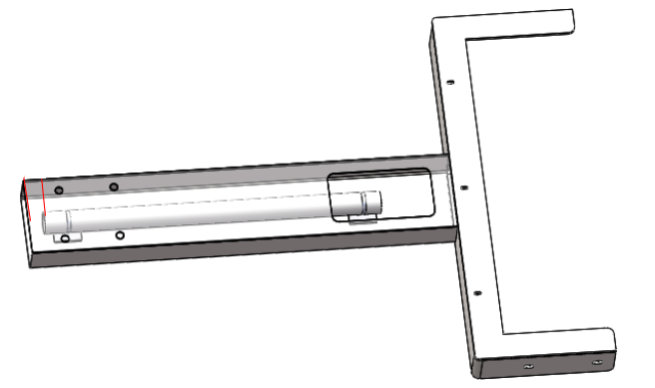
2. Fix【PVC short pipe】with 2【cable zip ties】and 2【zip tie mounts】inside the【support pillar】.

Slide 6
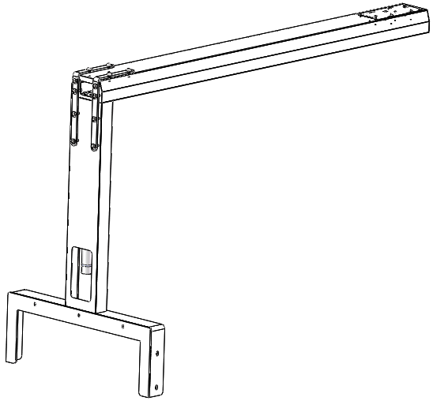
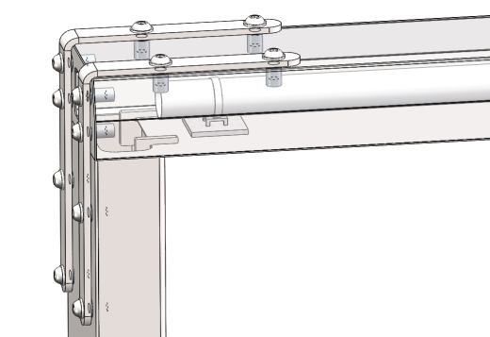
3. Use【5mm Hex key】、12【M8x20 hexagon socket head cap screws（including washers）】and 2【L-shaped Organizers 】to fix【support pillar】with【Ladder Organizer】mounting holes firmly.

Slide 7
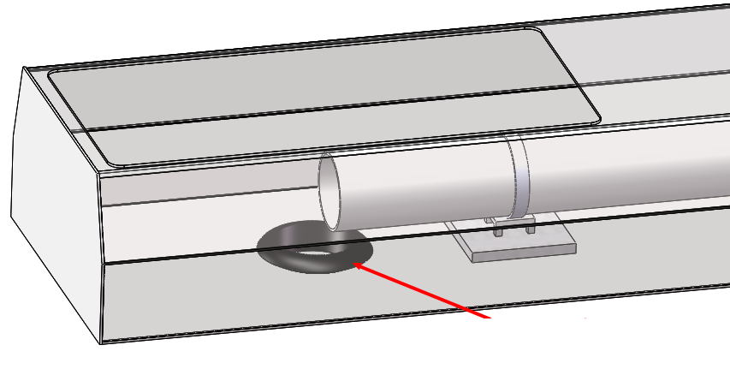
4. Put the【double-sided dust-proof coil】into the round hole of the 【 Ladder Organizer】.

Slide 8
5. Screw in 2【Non-slip foot cup】into the M8 threaded Hole of【The anti-dumping support】.
（Need to be fully screwed in）.

Slide 9
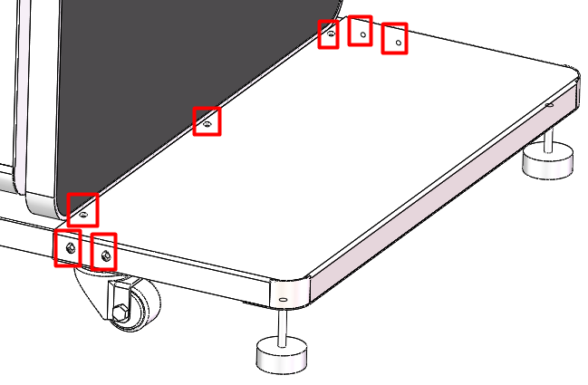
6. Use 4【M5x12 hexagon socket head cap screws（including washers）】and 3【M4x12 hexagon socket head cap screws（including washers）】to fix【The anti-dumping support】on the【Control Center】，then adjust the【Non-slip foot cup】to make the Control Center parallel to the ground.
Tools you need:【2.5mm Hex key】、【3mm Hex key】、【13mm Open-end wrench】

Slide 10
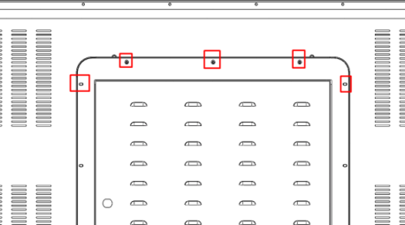
7. Remove the 5【M4x6 Phillips Pan Head Machine Screws】from 【Control Center box】using【Phillips screwdriver】.

Slide 11
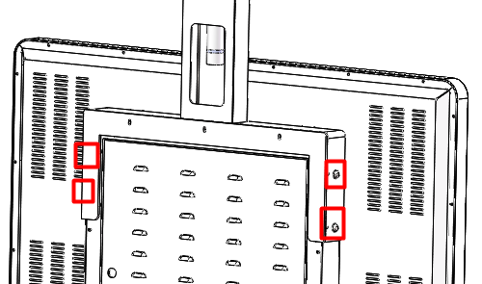
8. Fix the 【support pillar】of the Cord Organizer with the 【Control Center box】side hole using 4【M8x25 hexagon socket head cap screws（including washers）】and 4【M8 1 hexagon nuts】(Don't tighten it first ）. Tools:【5mm Hex key】、【13mm Open-end wrench】.

Slide 12
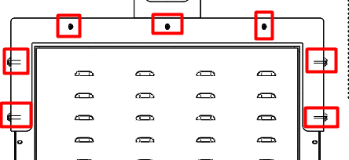
9. Then use 3【M4x12 hexagon socket head cap screws】to fix the【support pillar】with【Control Center box】holes. After that tighten these 7【screws】firmly.
Tools you need:【2.5mm Hex key】、【5mm Hex key】、【13mm Open-end wrench】.

Slide 13
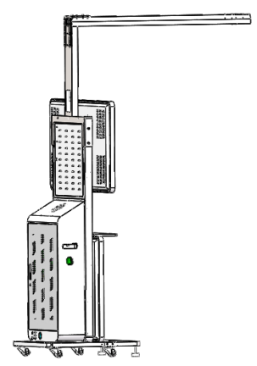
Effect drawing after installation as below photo shows:

Slide 14
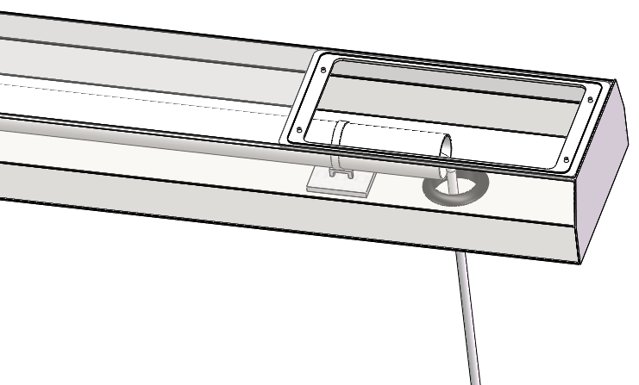
3、Wireharness connected to headset
1. Put 【wires of the headset】into the【PVC pipe】in the head of【Ladder Organizer】through 【double-sided dust-proof coil】，continously reach【Ladder Organizer】tail end ，pull out wires of the headset for about 1 meter .
here put into wires of the headset
here put out wires of the headset (about 1m)

Slide 15
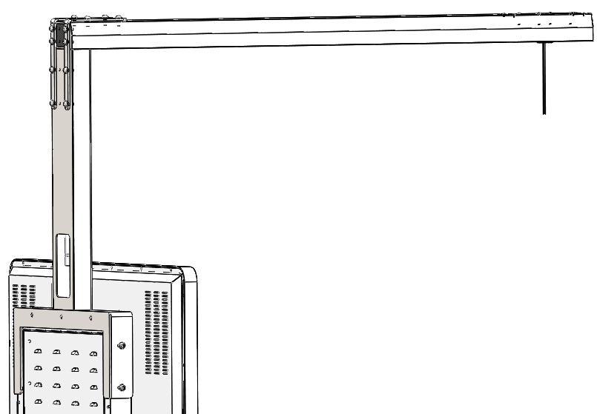
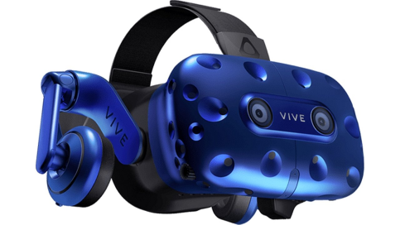
1. Put wires of the headset into 【PVC pipe】of the【support pillar】，continously reach internal 【Control Center box】. Connect wires of the headset to Streaming box.
Connect wires of the headset to Streaming box. (Streaming box is inside the back shell of Control Center)
connect the wires with headset

Slide 16
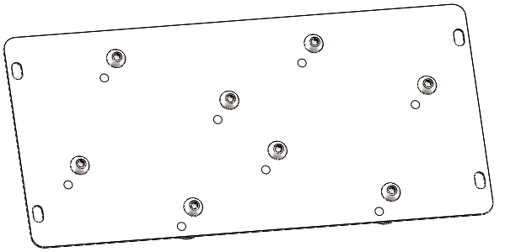
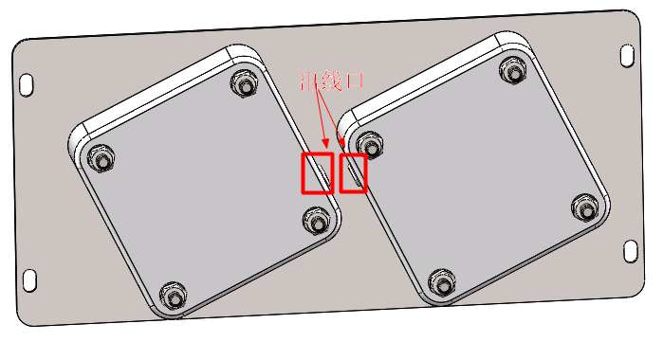
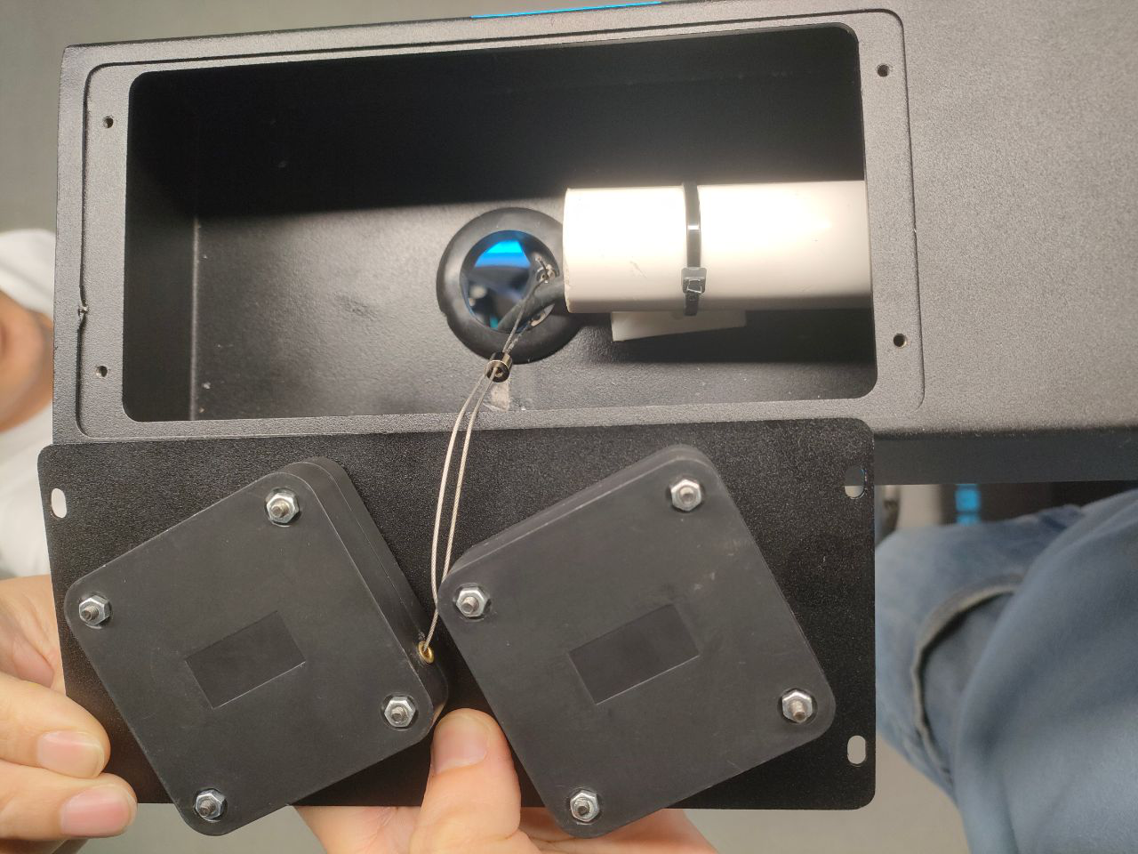
2. Use 8【M4x25 hexagon socket head cap screws（including washers）】and 8【M4 1 Hex nut】fix the 【cord organizers】on the【cord organizers cover】（Pay attention to the location of the outlet shown in the 2nd photo）.
Tool you need：【2.5mm Hex key】、【7mm Open-end wrench 】
before cord organizers installed
after cord organizers installed

Slide 17
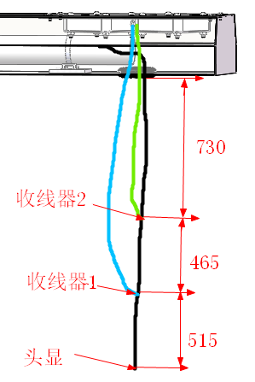
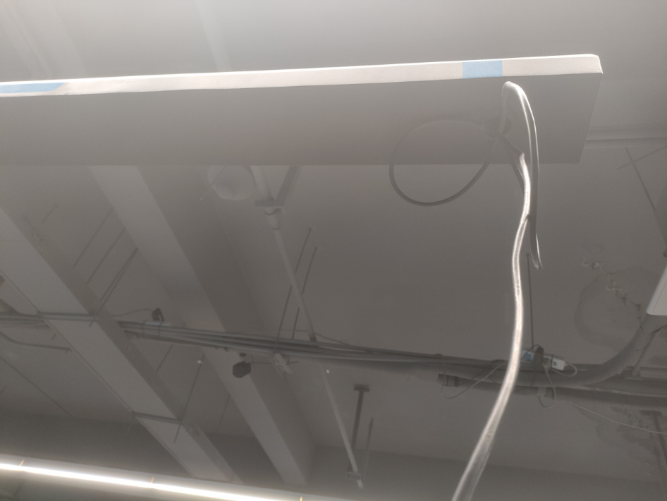
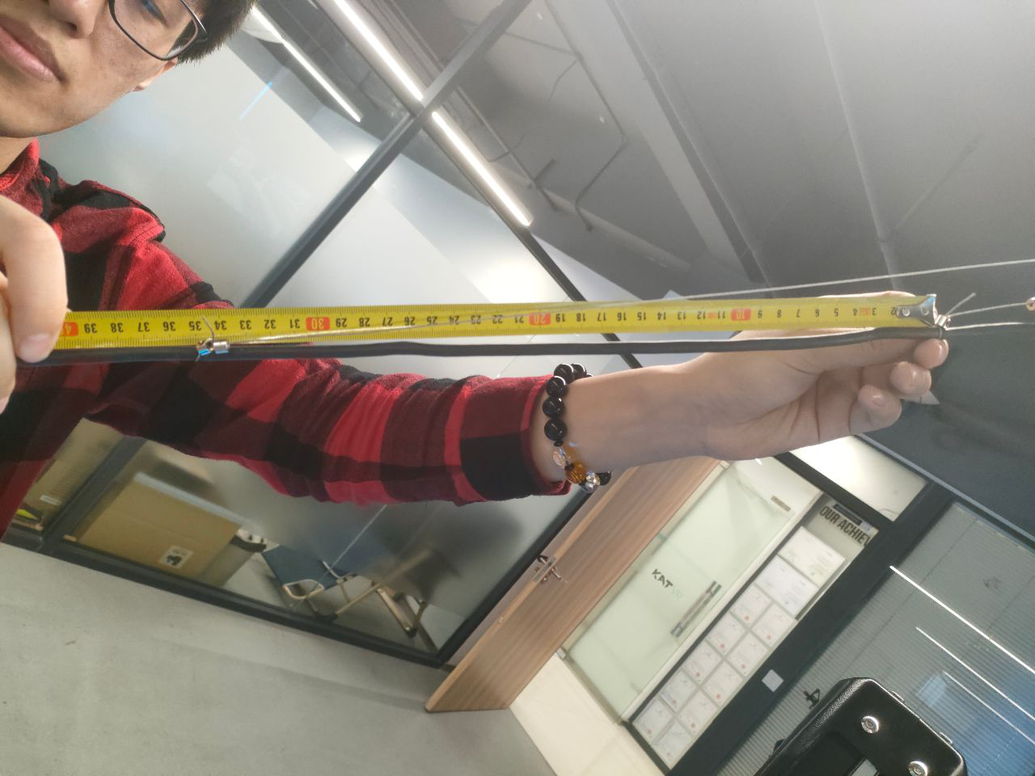
3. Put through wires of the headset to cord organizer 1 and cord organizer 2, the wire length between the fixed point of the headset (at the tail of the headset) and the cord organizer 1 should be 515 mm, and the wire length between the fixed point of cord organizer 1 and cord organizer 2 should be 465 mm.
Adjust the screw holes (use a 1.5mm Hex key) to fix the wire on the headset wire
Distance between the 2 fixed points is about 300-450mm(within this range is okay)

Slide 18
After put through wires of the headset to cord organizer 1 and cord organizer 2, the length of the stretched headset wire can be adjusted in two stages, as shown in the video below .

Slide 19
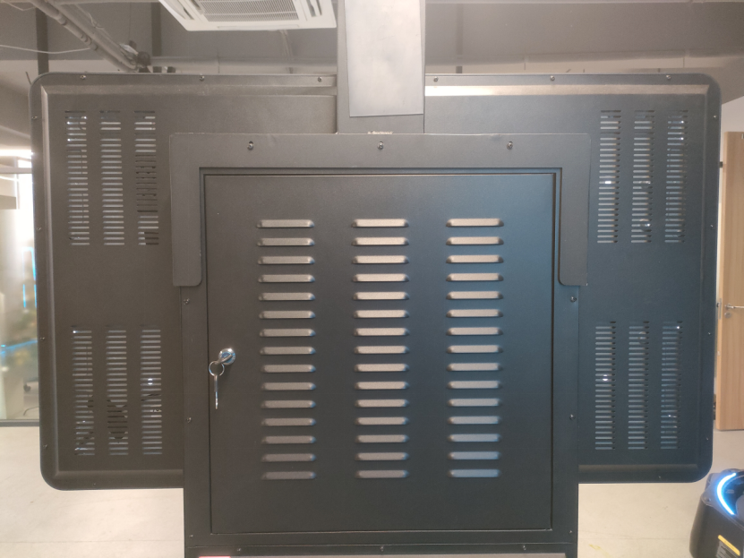
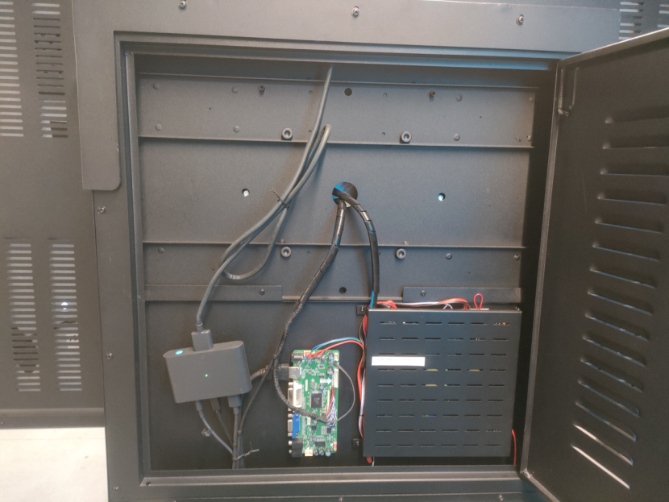
4. Open the machine back shell and fix the【wires of the headset】and【Streaming box】with【zip tie mounts】.
the back shell of Control Center
effect drawing after installation
open the back shell
Streaming box

Slide 20
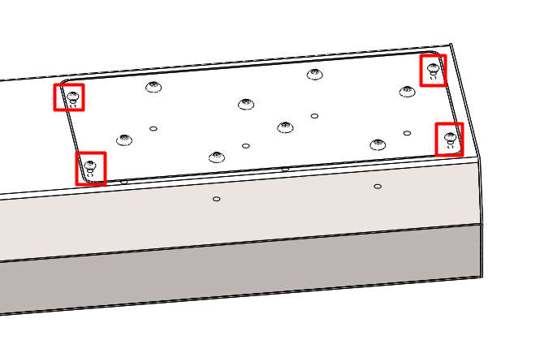
5. Fix【cord organizer cover】（including cord organizers）with【Ladder Organizer 】firmly using 4【M3x6 hexagon socket head cap screws（including washers）】.
Tool you need：【2mm Hex key】

Slide 21
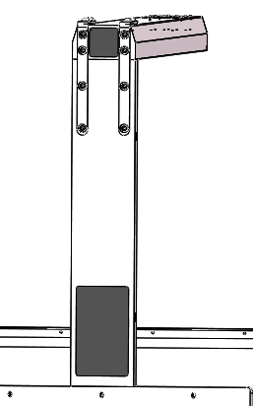
6. Cover [Magnetic Sticker 1] and [Magnetic Sticker 2] 。

Slide 22
After completing all the above installation steps, be sure to check the following items again:
1. The anti-dumping support is well supported, the control center is stable as a whole, and there is no risk of dumping;
2. Ensure the installation of the headset cable is normal, ensure it is not too loose or too tight;
3. After connecting the harness of the headset, check whether the headset function is normal (for the installation method of the headset, please refer to the HTC vive Pro headset installation guide)

